Slide 1

Garage Inventory System
Team Members: Sai Teja Namani, Nikhil Sriram Budamaguntala, Rohith Sai Kanchi

Slide 2
Overview of the Project
Built an application that reflects the works of a Garage, this will help to improve the work environment where the clients can manage the work easily and this is a user-friendly application that helps the users to provide their information and problem through the application.
This reduces the workload of the clients, labor, and users as they update the details in real-time and get to know all the works that need to be done.
We developed the UI and other data using various tools like Azure Data Studio, Microsoft Power Apps, and implemented different SQL concepts.
The Garage Inventory System helps to reduce the time load of the labor, and users and to prevent miscommunications in workplace.

Slide 3
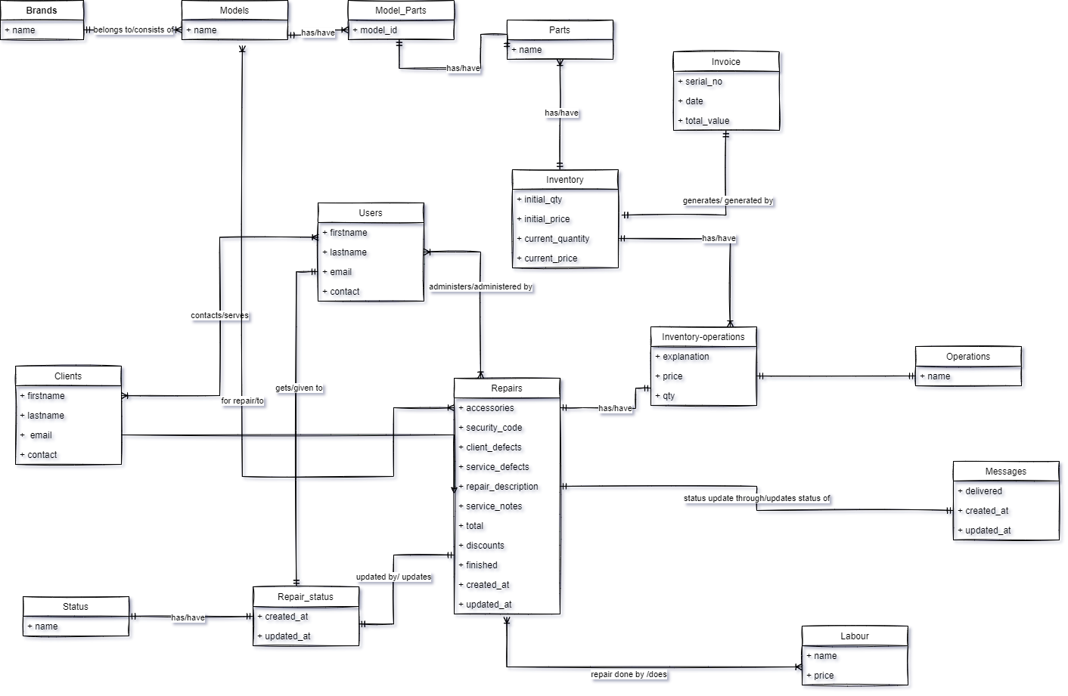
Conceptual Model

Slide 4
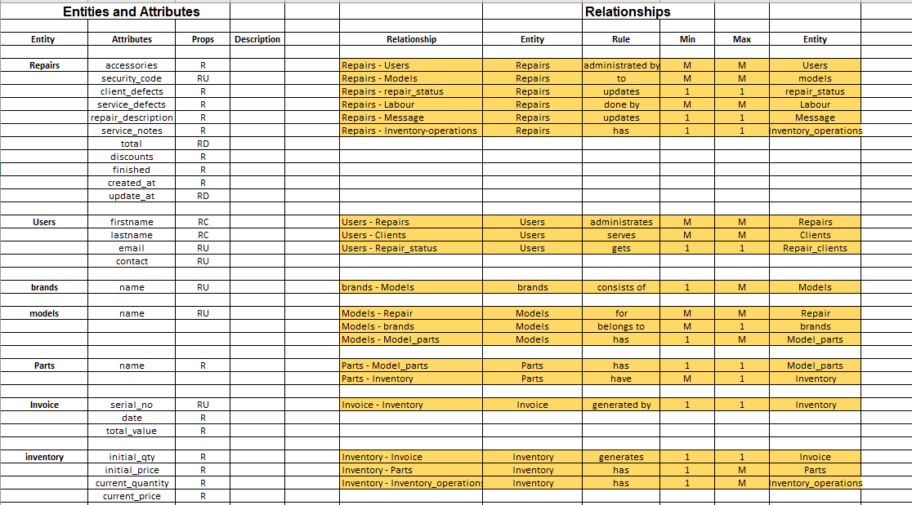
E-R Requirements SpreadSheet

Slide 5
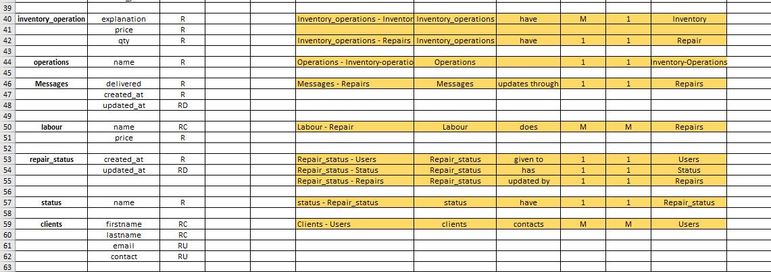
E-R Requirements SpreadSheet

Slide 6
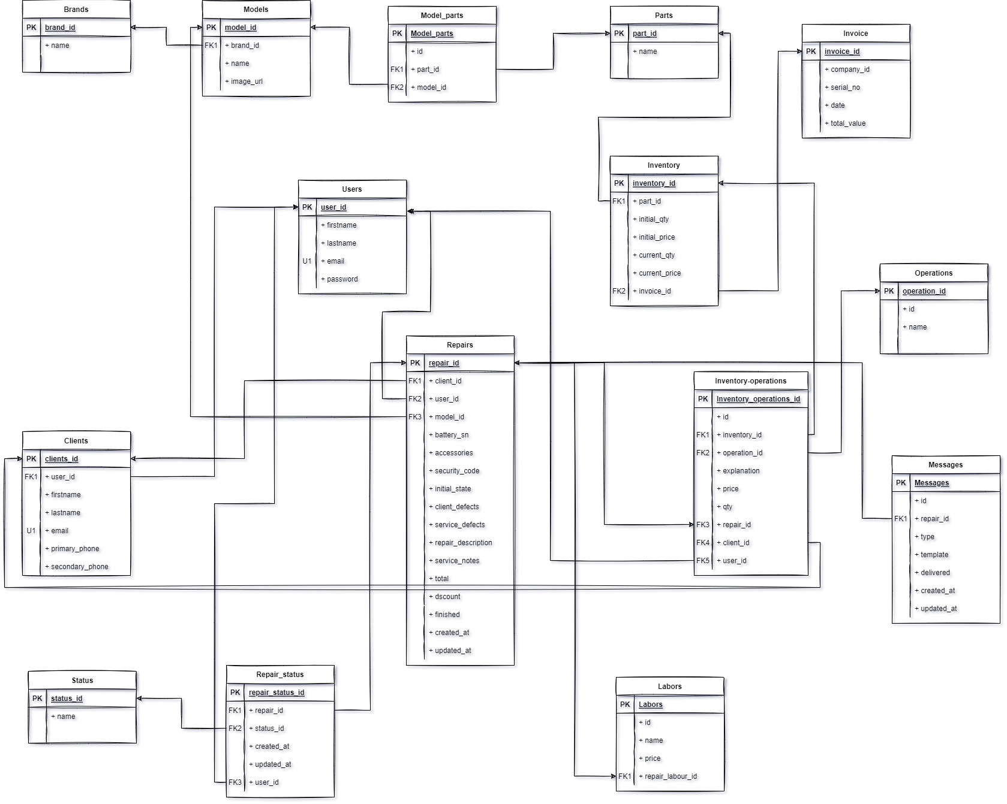
Logical Model

Slide 7
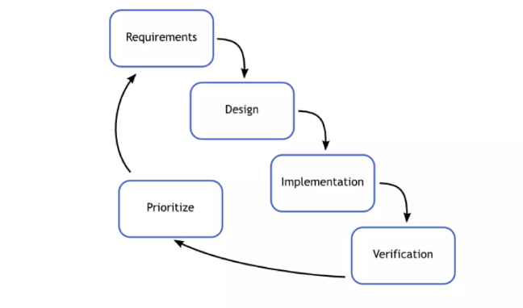
Reflection on design and Implementation
Agile S/W development to complete the project which breaks tasks into small increments with minimal planning.
Here we first understood the business problem and gathered all the requirements and divided our requirements into different stages.
Conceptual stage: Here we drafted all the functionalities and completed the ER diagram.
Logical Stage: We added the structure between the tables and added the required keys.
Implementation stage: We implemented the database model using SQL in Azure Data Studio and added the data to the tables.
Verification stage: Here we verified the data by viewing the tables and developed the UI using Power Apps.
Agile development interpreted in the waterfall model

Slide 8
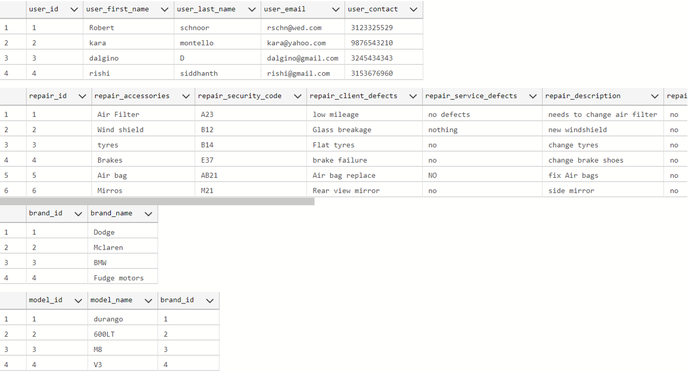
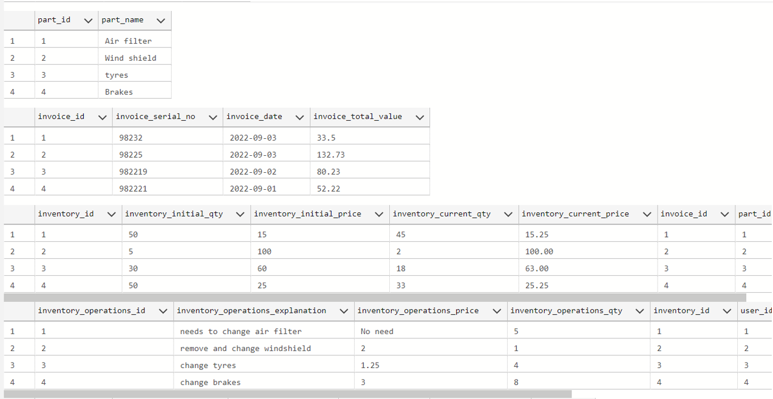
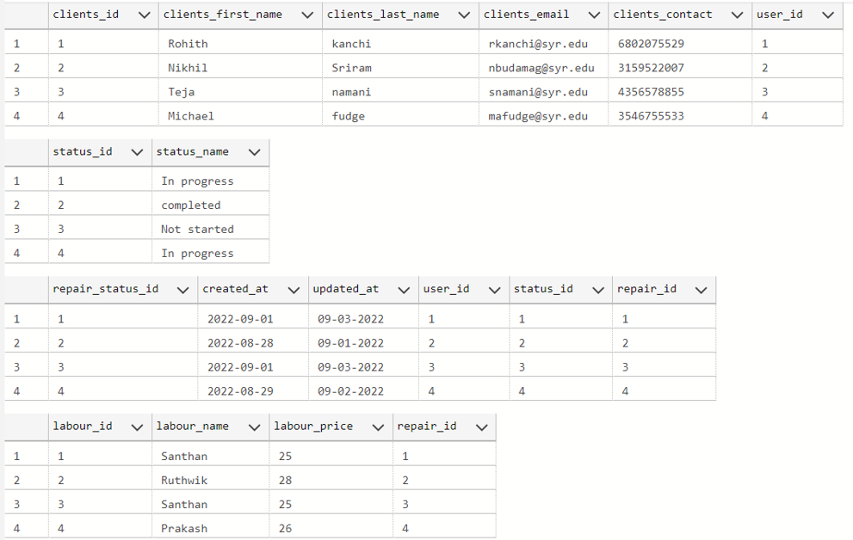
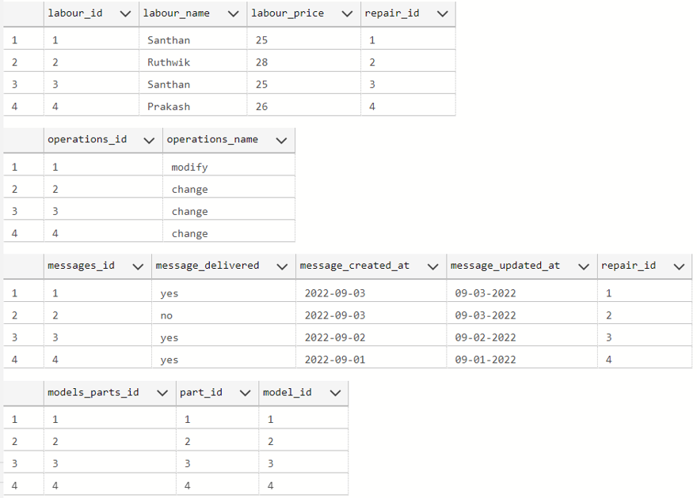
The Data present in the tables

Slide 9
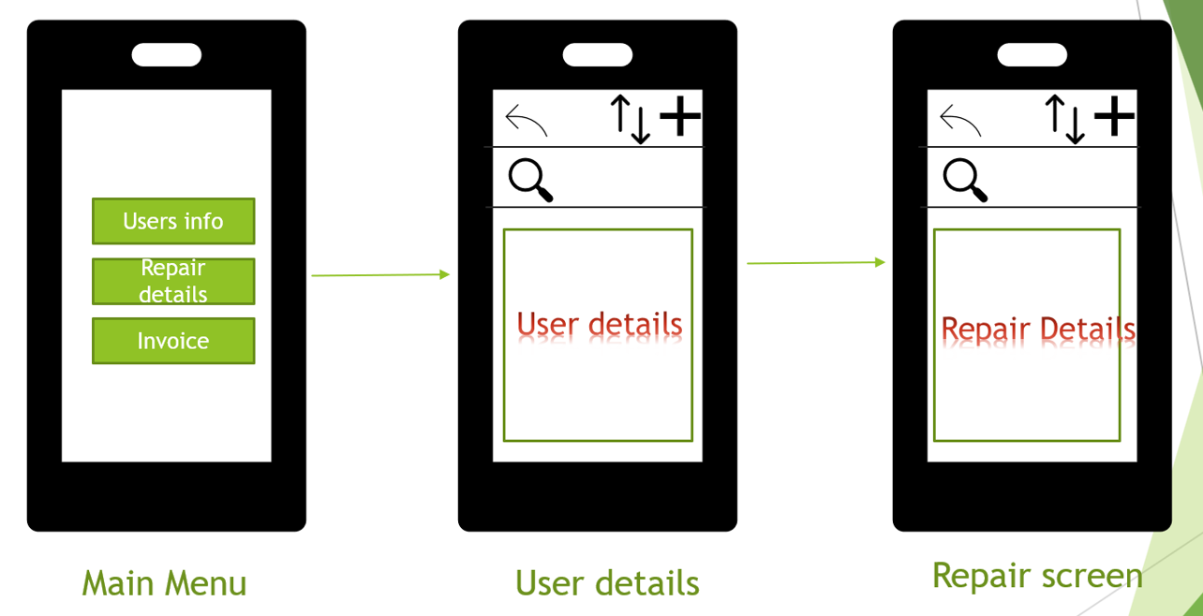
Basic Layout of Application screens

Slide 10
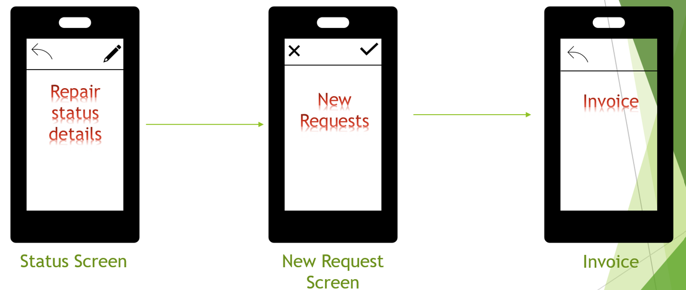
Basic Layout of Application screens

Slide 11
Thank You

